Slide 1
Bluetooth Based Home Automation Project Using Android Phone
S.Nagendran(920121105701)
(be).,EEE – iii year
Bharath Niketan Engineering College,
Aundipatti,Theni (Dt).
Submitted by,

Slide 2
Aim:
To design an Bluetooth home automation system to control home appliances (e.g., lights
or fan) via android app.
Apparatus Required:
1 ESP 32 Bluetooth 1
2 Relay switch module 1
3 Bread board 1
4 Jumper wires few
5 Bulb 1
6 Bulb Holder 1
7 5v Adapter, 1A 1

Slide 3
Theory:
The design is based on a standalone Arduino BT board and the home appliances are
connected to the input/ output ports of this board via relays. The communication between the
cell phone and the Arduino BT board is wireless.

Slide 4
Procedure:
ð The connection are given as per the circuit diagram.
ð The input power supply as given the +vcc at esp32.
ð Turn ON mobile Bluetooth and pair the esp32.
ð Open the Bluetooth switch app and tap on “tap to connect”.
ð Select the esp32_BT from the list.
ð Now we can control the relay from mobile with Bluetooth.

Slide 5
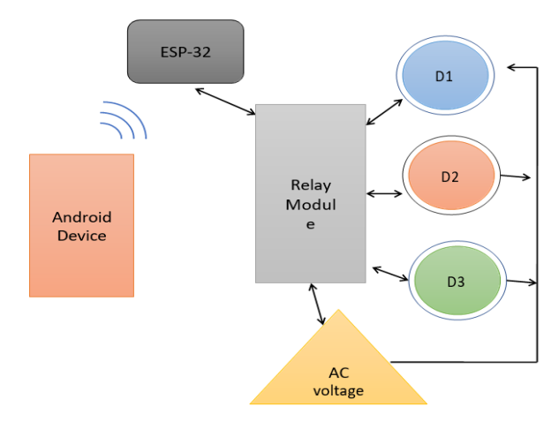

Slide 6
Program Code:
#include "BluetoothSerial.h"
#include <AceButton.h>
using namespace ace_button;
#if !defined(CONFIG_BT_ENABLED) || !defined(CONFIG_BLUEDROID_ENABLED)
#error Bluetooth is not enabled! Please run
`make menuconfig` to and enable it
#endif
BluetoothSerial SerialBT;
// define the GPIO connected with Relays and switches
#define RelayPin1 23 //D23
#define RelayPin2 22 //D22
#define SwitchPin1 13 //D13
#define SwitchPin2 12 //D12

Slide 7
int toggleState_1 = 1; //Define integer to remember the toggle state for relay 1
int toggleState_2 = 1; //Define integer to remember the toggle state for relay 2
char bt_data; // variable for storing bluetooth data
ButtonConfig config1;
AceButton button1(&config1);
ButtonConfig config2;
AceButton button2(&config2);
void handleEvent1(AceButton*, uint8_t, uint8_t);
void handleEvent2(AceButton*, uint8_t, uint8_t);
void all_Switch_ON(){
digitalWrite(RelayPin1, LOW); toggleState_1 = 0; delay(100);
digitalWrite(RelayPin2, LOW); toggleState_2 = 0; delay(100);
}
void all_Switch_OFF(){
digitalWrite(RelayPin1, HIGH); toggleState_1 = 1; delay(100);
digitalWrite(RelayPin2, HIGH); toggleState_2 = 1; delay(100);
}

Slide 8
void Bluetooth_handle()
{
bt_data = SerialBT.read();
// Serial.println(bt_data);
delay(20);
switch(bt_data)
{
case 'A': digitalWrite(RelayPin1, LOW); toggleState_1 = 0; break; // if 'A' received
Turn on Relay1
case 'a': digitalWrite(RelayPin1, HIGH); toggleState_1 = 1; break; // if 'a' received Turn
off Relay1
case 'B': digitalWrite(RelayPin2, LOW); toggleState_2 = 0; break; // if 'B' received Turn
on Relay2
case 'b': digitalWrite(RelayPin2, HIGH); toggleState_2 = 1; break; // if 'b' received Turn
off Relay2

Slide 9
case 'Z': all_Switch_ON(); break; // if 'Z' received Turn on all Relays
case 'z': all_Switch_OFF(); break; // if 'z' received Turn off all Relays
default : break;
}
}
void setup()
{
Serial.begin(9600);
btStart(); //Serial.println("Bluetooth On");
SerialBT.begin("ESP32_BT"); //Bluetooth device name
Serial.println("The device started, now you can pair it with bluetooth!");
delay(5000);
pinMode(RelayPin1, OUTPUT);
pinMode(RelayPin2, OUTPUT);
// pinMode(wifiLed, OUTPUT);

Slide 10
pinMode(SwitchPin1, INPUT_PULLUP);
pinMode(SwitchPin2, INPUT_PULLUP);
//During Starting all Relays should TURN OFF
digitalWrite(RelayPin1, toggleState_1);
digitalWrite(RelayPin2, toggleState_2);
config1.setEventHandler(button1Handler);
config2.setEventHandler(button2Handler);
button1.init(SwitchPin1);
button2.init(SwitchPin2);
delay(200);
}
void loop()
{
if (SerialBT.available()){
Bluetooth_handle();
}
button1.check();
button2.check();
}

Slide 11
void button1Handler(AceButton* button, uint8_t eventType, uint8_t buttonState) {
Serial.println("EVENT1");
switch (eventType) {
case AceButton::kEventPressed:
Serial.println("kEventPressed");
toggleState_1 = 0;
digitalWrite(RelayPin1, LOW);
break;
case AceButton::kEventReleased:
Serial.println("kEventReleased");
toggleState_1 = 1;
digitalWrite(RelayPin1, HIGH);
break;
}
}

Slide 12
void button2Handler(AceButton* button, uint8_t eventType, uint8_t buttonState) {
Serial.println("EVENT2");
switch (eventType) {
case AceButton::kEventPressed:
Serial.println("kEventPressed");
toggleState_2 = 0;
digitalWrite(RelayPin2, LOW);
break;
case AceButton::kEventReleased:
Serial.println("kEventReleased");
toggleState_2 = 1;
digitalWrite(RelayPin2, HIGH);
break;
}
}

Slide 13
Result:
Thus the design of an home automation to control home appliances (e.g., lights or fan)
via android app using Bluetooth was done.

Slide 14
Thanking you

